Slide 1
College Technical Math 1
Section 4.3
Time, Temperature and Other Measures

Slide 2
Other Conversions
The tables from the textbook contain the conversion factors for:
Units of time
Units of temperature (Fahrenheit and Celsius)
Converting between the US Customary and Metric system of measures

Slide 3
Time Conversion
If you studied for 3.5 h, how many minutes did you study? (Example)
$$3.5\left(60\right)=210 min$$
From the table “h to min multiply by 60”

Slide 4
Time Conversion
If you studied for 3.5 h, how many minutes did you study? (Example)
$$3.5 hr\left(\frac{60 min}{1 hr}\right)=210 min$$
From the table

Slide 5
Time Conversion
A process takes 182 s to perform. How many minutes is this? (Example)
$$182\left(0.016667\right)≈3.03 min$$
From the table “sec to min multiply by 0.016667”

Slide 6
Time Conversion
A process takes 182 s to perform. How many minutes is this? (Example)
$$182 sec\left(\frac{1 min}{60 sec}\right)≈3.03 min$$
From the table

Slide 7
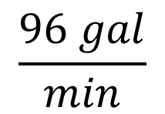
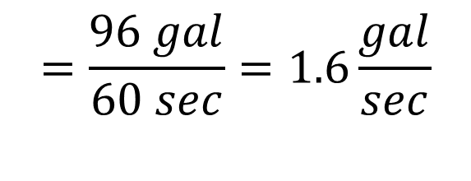
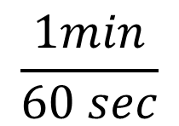
Time Conversion
If water flows through a fire hose at the rate of $96 \frac{gal}{min},$how many gallons will flow per second? (Example)
$$\frac{96 gal}{min}$$
$$\frac{1min}{60 sec}$$
$$=\frac{96 gal}{60 sec}=1.6\frac{gal}{sec}$$

Slide 8
Time Conversion
How many days are in 36 h? (Skill Check)
$$1.5 days$$
A physical test took 5.3 min to perform. How many seconds is this? (Skill Check)
$$318 sec$$

Slide 9

Time Conversion
A pump can dispose of sludge at a rate of $3,600\frac{lb}{h}.$ How many pounds can be disposed of per minute? (Skill Check)
$$60\frac{lb}{min}$$

Slide 10
Temperature Conversions
Fahrenheit to Celsius:
$$℃=\frac{5}{9}(℉−32)$$
1. Subtract 32 from the $℉$ temperature
2. Multiply the difference by $\frac{5}{9}$

Slide 11
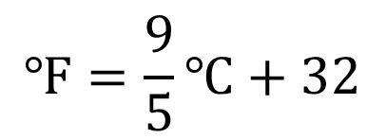
Temperature Conversions
Celsius to Fahrenheit:
$$℉=\frac{9}{5}℃+32$$
1. Multiply the $℃$ by $\frac{9}{5}$
2. Add 32 to the product

Slide 12
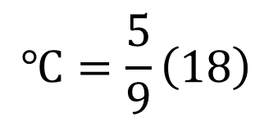
Temperature Conversions
Convert $50℉$ to $℃$ (Example)
$$℃=\frac{5}{9}\left(50−32\right)$$
$$℃=\frac{5}{9}\left(18\right)$$
$$℃=10$$

Slide 13
Temperature Conversions
Convert $15℃$ to $℉$ (Example)
$$℉=\frac{9}{5}\left(15\right)+32$$
$$℉=27+32$$
$$℉=59$$

Slide 14
Temperature Conversions
Convert $95 ℉$ to $℃$. (Skill Check)
$$35 ℃$$
Convert $215 ℃$ to $℉$. (Skill Check)
$$419 ℉$$

